Slide 1
Angular Routing
Server-side and Client-side Routes
Generating a new page component
Setting up the router and adding routes
router-outlet and routerLink

Slide 2
Routes
Routes are fundamental to how the app is structured so it is important to understand how they work.
There are two kinds of routes: server-side and client-side.

Slide 3
Interacting with a server-side web app
Server-side web apps are code, and the concept of directories and files is less applicable
Additionally a web aps code structure is often complex and we don't want to expose it to the browser
http://example.com/myApp/shoppingCart/addToCart.php
Server
addToCart.php
Browser
example.com
myApp/shoppingCart/addToCart.php
Response HTML

Slide 4
Server-side Routes
Routes became popular as a virtual URL that doesn't apply to any specific directory or file
The previous URL(endpoint) could be simplified to: http://example.com/addToCart
For this to work the web app needs a routing table to connect virtual URLs to code
This was popularised in MVC web frameworks such as Ruby on Rails, e.g.

Slide 5
Client-side Routes
Client-side web apps, i.e. JavaScript in the browser, didn't typically utilise URLs for navigation
JavaScript events and functions were used to interact with web apps
URLs were primarily used to change pages
However, routes are a tidy way to manage navigation even in single page web apps

Slide 6
Angular routes
Angular routes allows the web app to have a table, matching routes to components.
Routing in angular is different to standard express projects. In express all controller functions are linked in a top down fashion through routing; where a routes consists of a URL/URI path and link to a controller function or model. In angular routes link directly to page components.
Each page component consist of an HTML view, an ng data model, and a supporting controller class and functions.
In angular the "src/app/app.component.html" acts like a parent view which all generated pages get loaded into when navigated to.

Slide 7
Generating a New Page Component
Generating a new component can be done through the angular CLI using the command:
ng generate component “pageName"
All generated pages are located in the src/app/ folder.
Before you can open those web address' like localhost:4200/pageName, you need to add a route for the page component into the Angular router.

Slide 8
Setting Up the Router
In Angular, the best practice is to load and configure the router in a separate, top-level module that is dedicated to routing and imported by the root AppModule.
By convention, the module class name is AppRoutingModule and it belongs in the app-routing.module.ts in the src/app folder. It can be set when the angular project is generated or gennerated by CLI command:
ng generate module app-routing --flat --module=app

Slide 9
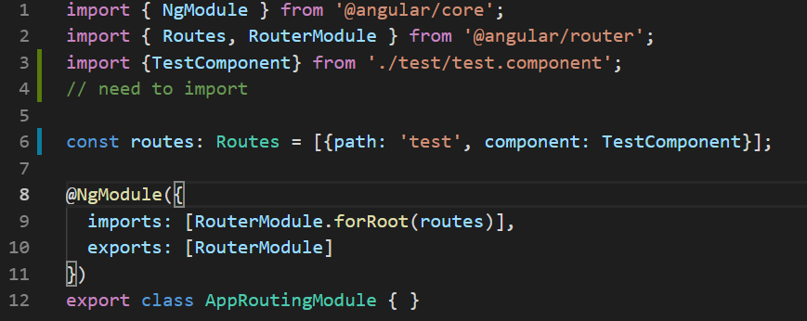
Adding a route
Routes tell the router which view to display when a user clicks a link or pastes a URL into the browser address bar.
A typical Angular Route pairs a path and component. This is created as an object that is saved to variable of type Routes.

Slide 10
Adding router-outlet and routerLink
The <router-outlet> tells the router where to display routed views.
In the following AppComponent template, <a routerLink ="/test"> is a hyperlink that when clicked, will load the "test" component into the position held by the <router-outlet> tag.
<h1>{{title}}</h1> <nav> <a routerLink="/test">Test</a> </nav> <router-outlet></router-outlet>

Slide 11
Progromatic Navigation - navigate() & navigateByUrl()
Using routerLink we can hardcode a route for a component to always navigate to.
We can navigate to a route programmatically using the router property which is available in any component class and calls the navigate() or navigateByUrl() functions:
this.router.navigateByUrl('/account');

Slide 12
Importing Router Module
To access the router service we must first import what we need from the library package @angular/router.
import { Router } from '@angular/router’;
In the constructor we inject the router so that it is available in the class
constructor(private router: Router){}
In a method of the class we may reference this.router and navigateByURL() method of the router to route to a new component.
nav(){
this.router.navigateByUrl('/account');
}

Slide 13
Passing data via a Router Parameter
It is often useful to be able to pass parameters to a component.
Router Parameters allow us to pass variable data to a component.
With a routerLink we can pass a parameter to the component by using a square bracket syntax that will evaluate what is passed to it as a javascript expression rather that a literal string as in our previous example.
<a [routerLink] = "[ '/users', user.id ]" > {{user.username}} Profile </a>
The above example would create a route to the component that matches the "/user" path with a single parameter

Slide 14
Passing data via a Router Parameter
We can create our links programmatically if required.
nav(){
this.router.navigateByUrl('/user/' + user.id );
}
With navigateByUrl we pass a concatinated string with the required path.
nav(){
this.router.navigate(['/user' , user.id ]);
}
With navigate we pass an array of path components

Slide 15
Adding a Route with a Parameter
In the app-routing module we will have to create a route the matches the path and parameter options we just created.
const routes: Routes = [{ path:'users/:id', component:LoginComponent }]
A parameter is added to the path using a semicolon and a name for the parameter. The name used, will then be accessible within the component when it is created.

Slide 16
Access Routing Parameters in a component
We now have a Route that matches a path and parameter.
To access the parameter in the component we have two options.
The Snapshot Way and the Observable Way.
The Snapshot way allows us to easily access the parameters that were passed when the component first loads. You will have to import the ActivatedRoute Module to access the query parameters
The ActivatedRoute is a service that is provided to each route component that contains route specific information such as route parameters, static data, resolve data, global query params, and the global fragment.

Slide 17
Accessing the Parameter via snapshot
import { ActivatedRoute } from '@angular/router';
Once imported you can then inject the ActivatedRoute via the constructor.
constructor(private route: ActivatedRoute) {}
In the ngOnInit() lifecycle method you can access the parameter.
this.userid = this.route.snapshot.params.id;

Slide 18
The Observable Way
To improve performance angular will reuse components. If we had a component that shows user details and we move from one user to the next the component may not be reloaded (ie ngOninit() lifecycle method would not be triggered). This poses a problem.
The alternative to the Snapshot method is using an Observable.
An Observable is like a Stream and allows zero or more events to pass where the callback is called for each event. We will look at this in details in a future week.
We can initiate an observable that will give us access(stream over time) to the query parameters as we move from route to route. This is provided to us through the ActivatedRoute modules paramMap property.

Slide 19
Router Parameter the Observable Way
Firstly we import the ActivatedRoute module as with the snapshot way.
We inject the ActivatedRoute module via our constructor
In the ngOninit() lifecycle method we subscribe to the observable
ngOnInit(){
this.route.paramMap.subscribe(
params => {this.userid = params.get('id');}
);
}
This observer will continue to update the userid until the unsubscribe method is called.

Slide 20
Router Parameter the Observable Way
To unsubscribe from the observer we need to call its unsubscribe method. Firstly we need to get a reference to the subscription.
ngOnInit(){
this.routesubscription = this.route.paramMap.subscribe(params => {
this.userid = params.get('id');
});
}
A variable can be created in the class to store a reference to the subscription.
ngOnDestroy(){
this.routesubscription.unsubscibe();
}

